Slide 1
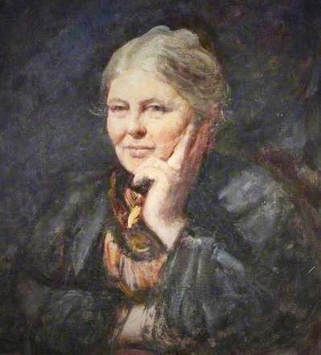
Charlotte Mason, portrait by Fred Yates 1901

Slide 2
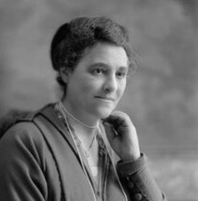
Henrietta Franklin, c.1895

Slide 3
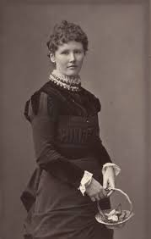
Emeline (Lienie) Steinthal, c.1886

Slide 4
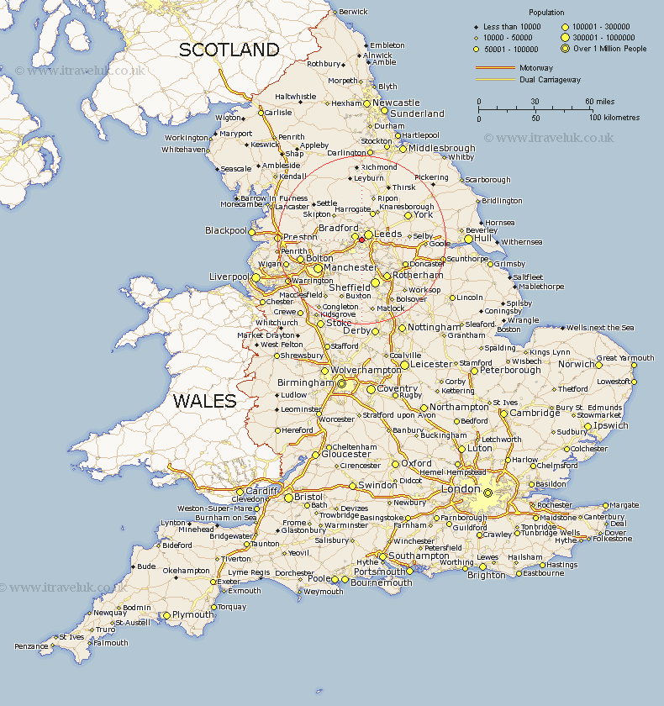

Slide 5
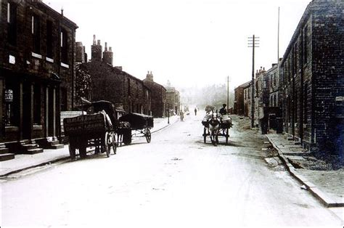
Drighlington, Yorkshire, c.1910

Slide 6
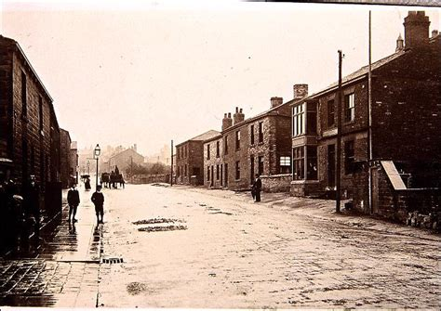
Drighlington, Yorkshire, c.1910

Slide 7
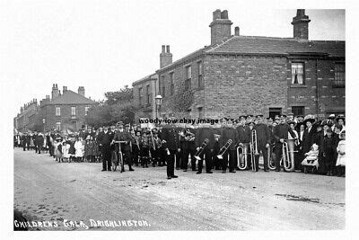
Drighlington Town Band, c.1910

Slide 8
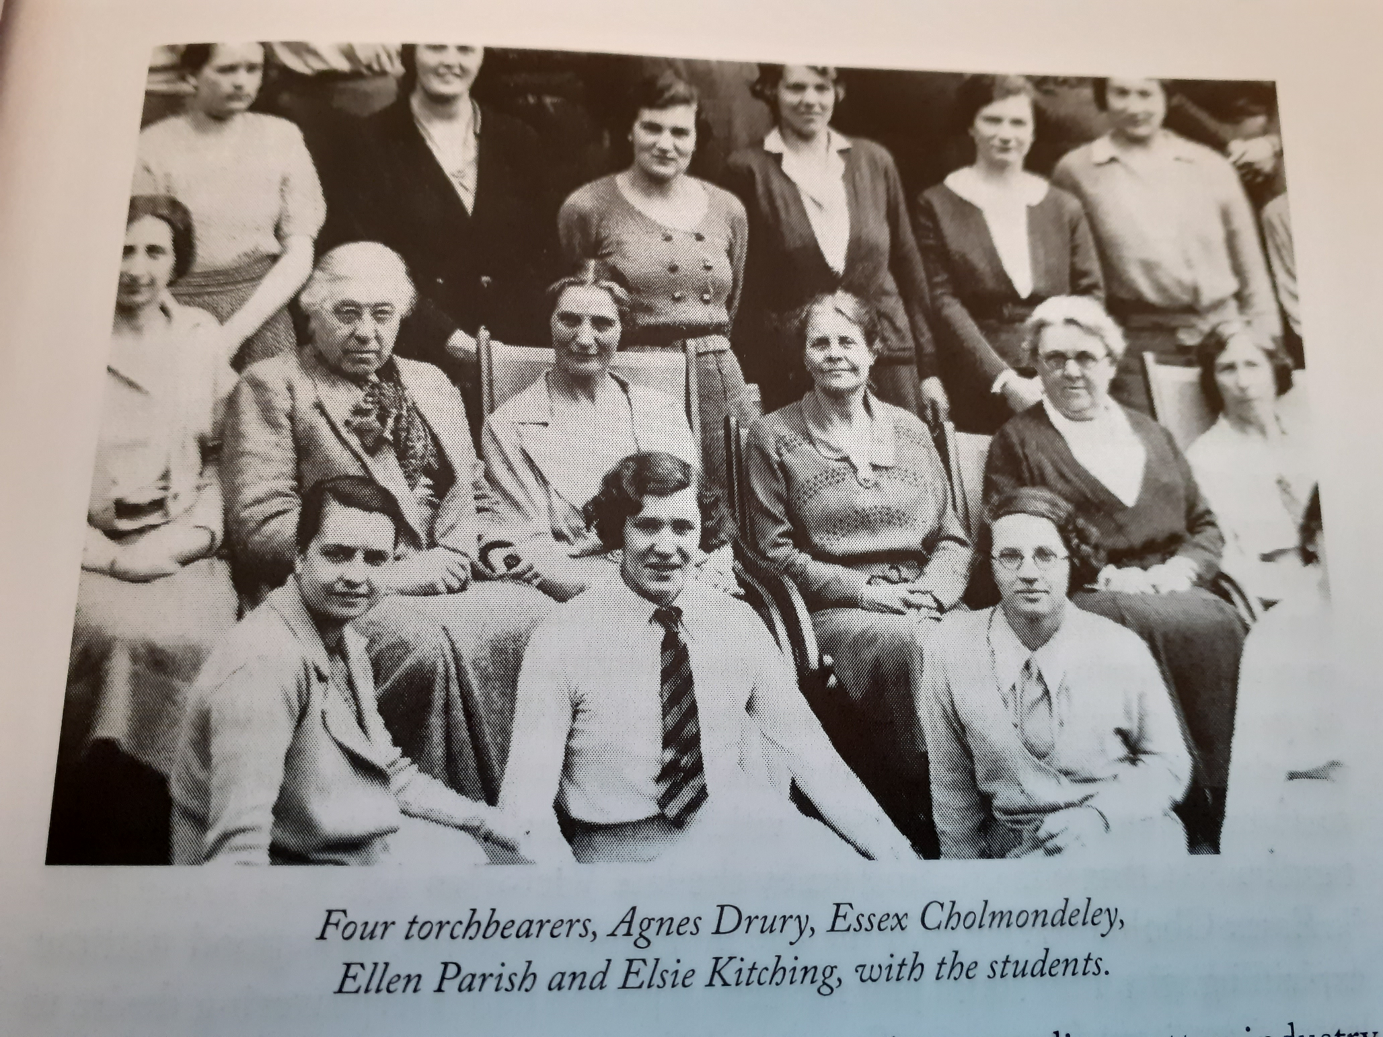

Slide 10
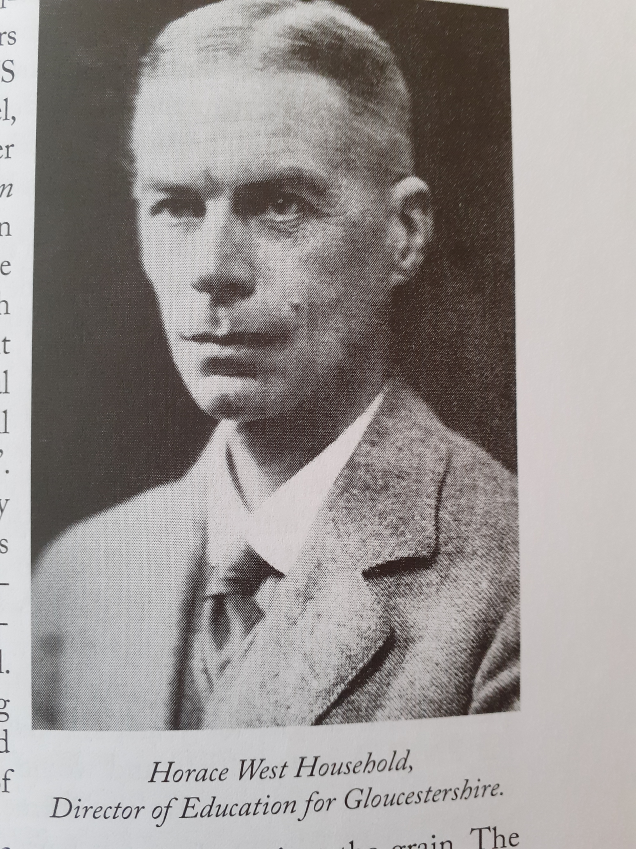

Slide 11
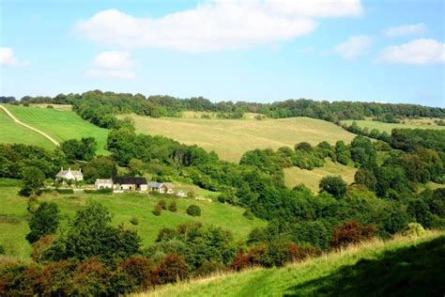
Gloucestershire countryside around Slad

Slide 12
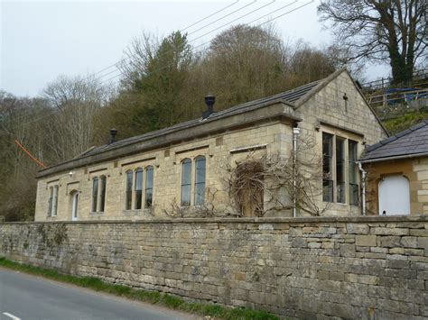
Slad Elementary School, Gloucestershire

Slide 13
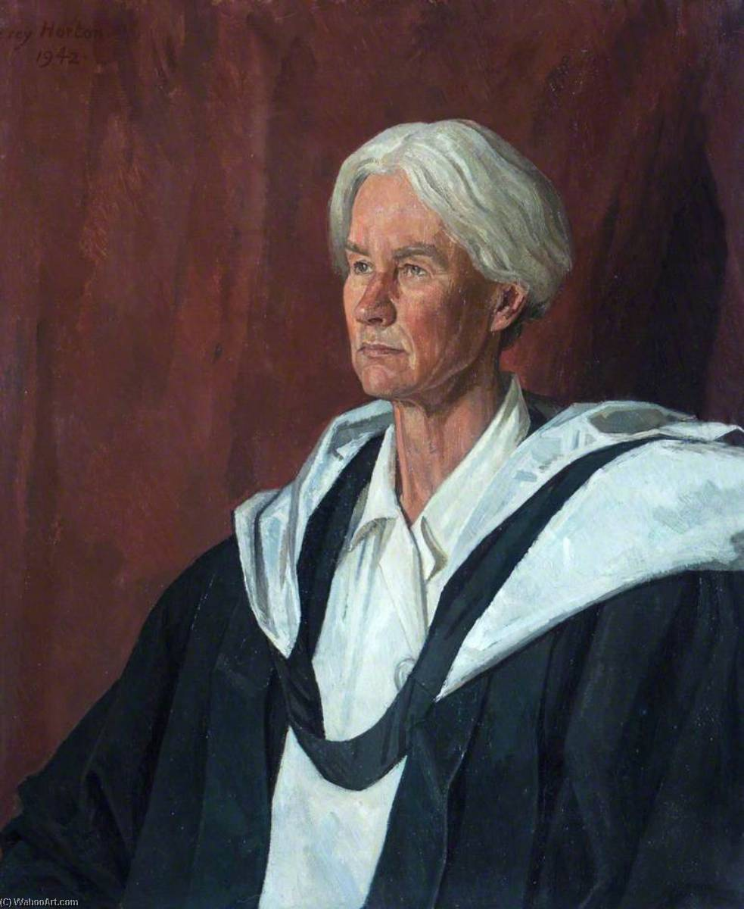
Helen Wodehouse, c.1925

Slide 14
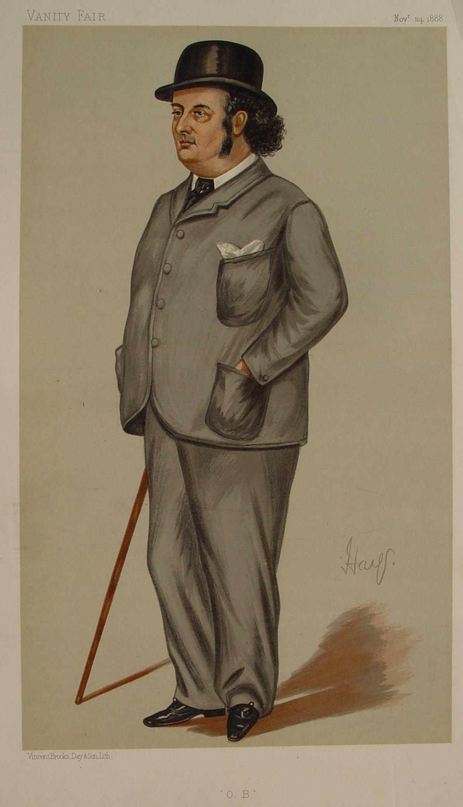
Oscar Browning, as caricatured in Vanity Fair (1888)

