Slide 1
Sensory Impairments
INCC4011
Notes:
Okay welcome to this presentation about sensory impairments. The first part of this presentation looks at hearing impairment the sorts of things that you might look out for, what some of the terminology means , how this'll impact on childrens learning and some of the things that you can do to support those children.
The second part of the presentation is about visual impairment and supports what you heard from Terry last week.

Slide 2
How do we measure hearing?
Notes:
When you receive an audiology report for a child you will see that there are two measures – the hearing level (how loud the sound is) and the frequency how high or low the pitch of the sound is

Slide 3
Catorgarising Hearning Loss
Notes:
The Mild to Moderate labels present a real problem for children as we tend to think they are not much of a problem, However they are not “normal” and they can cause children to have to work very hard to lip read, concentrate and fill in gaps leading to tiredness
You may know from your own experience that sometimes your hearing is not as acute as it usually is however and again this might be part of your experience perhaps with an elderly relative we are not always aware of the facts that are hearing is not normal.
If you have a child in your class who seems to never be listening doesn't follow instructions or becomes overly tired towards the end of the day and particularly if their behaviour changes from day to day or is worse when they have a snotty cold it is always a good idea to ask parents or carers to take the child for a hearing test. Particularly in early years and reception classes up to 10% of children can have an intermittent conductive hearing loss at any one time. Most local health authorities have a self referral system for all for audiology which can usually be found on the local authorities local offer.
So when you have a child who's been for audiology now likely to come back with a report from the audiologist explaining to you what level of hearing or hearing loss the child has got. Very often you will find the report says the child has a mild hearing loss and you perhaps think but this isn't too much of an issue. However the mild and moderate labels present a real problem for children precisely because we tend to think that they're not much of a problem. Mild to moderate hearing loss means that children are constantly thinking about or trying to support their hearing either by lip reading or copying the behaviour and actions of children around them; often to maintain their own feeling of self worth and confidence they try to hide the fact that they're struggling.

Slide 4
What can you hear with mild to moderate hearing loss?
Notes:
Some of the issues for children with mild to moderate hearing loss is the incidental learning that they miss out on. We can manage direct teaching usually by using technology such as hearing loops and sound systems like the one we have in our classroom. Children however learn a lot more then what we teach them. They pick up language skills from hearing adults speak together, they learn about the world from environmental sounds like birdsong, wind in the trees and even passing traffic. Social situations such as group work, pee lessons and lunch and break times often depend on chatter and oddments of utterances shouted to each other across the classroom.

Slide 5
Experience Hearing Loss
Experience Hearing Loss with the Flintstones
Notes:
Have a listen to this clip from the Flintstones. The sausage shape on Fred's chart shows where his hearing loss is and as the volume and pitch changes you can see the red line dip into Fred's hearingloss. Imagine how hard you would have to work at school and at home if your hearing loss was even in the mild category. Children with hearing loss can become very tired or may just give up expecting or trying to hear what is going on in the classroom full stop

Slide 6
Mild Hearing Loss
Mild Hearing Loss huge impact

Slide 7
Types and causes Hearing Loss
Conductive- a “blockage" along the pathway of sound. This could be in the outer ear – lots of wax, a perforated ear drum OR in the middle ear e.g. glue ear
Sensori- neural – damage to the inner ear or beyond. This could be damage to the hair cells in the inner ear OR damage to the hair cells in the inner ear OR damage along the nerve fibres to the brain
Mixed - Conductive hearing loss is the most common
Notes:
So there are three types of hearing loss which occur for different reasons. A conductive hearing loss is where something disrupts sound travelling from the outer ear the bit you can see on the outside of your head through the ear drum or into the middle or inner ear. this can be for reasons such as a hole in your ear drum,glue ear really common in small children (this is because the small tube the eustachian tube is particularly small in little children), or damage or loss of the three tiny bones in the ear.
Neural hearing loss is due to damage in the in the air it could be to do with the hair cells or the nerve fibers that run to the brain. The third type of hearing loss is mixed so a combination of conductive and sensorineural. Conductive hearing loss is most common particularly in children wait Gloria is

Slide 8
Glue Ear
Notes:
Have a look at this diagram of the ear notice where them outer and middle ear becomes the inner ear and have a look for the tiniest station tubes which cause all the problems with glue ear stop

Slide 9
Glue ear
Is a build up of sticky fluid in the middle ear
May cause pain
Four out of five children will experience it to some degree at some point.
Although not usually serious in itself it can cause long term difficulties in other areas of development
Hearing loss may come and go
Notes:
Glue ear is really common particularly in early years or in reception after that children grow and the eustachian tube which clears the sticky fluid from the middle ear. Gloria tends to come and go giving rise to intermittent hearing loss. Unfortunately during periods of hearing loss children can miss crucial parts of learning for example a two week cold causing blocked ears chenming children learning two or three crucial phonemes. Children who are prone to hearing loss may also fail to develop good listening and attention skills or even begin to believe that they are not able to learn like other children.

Slide 10
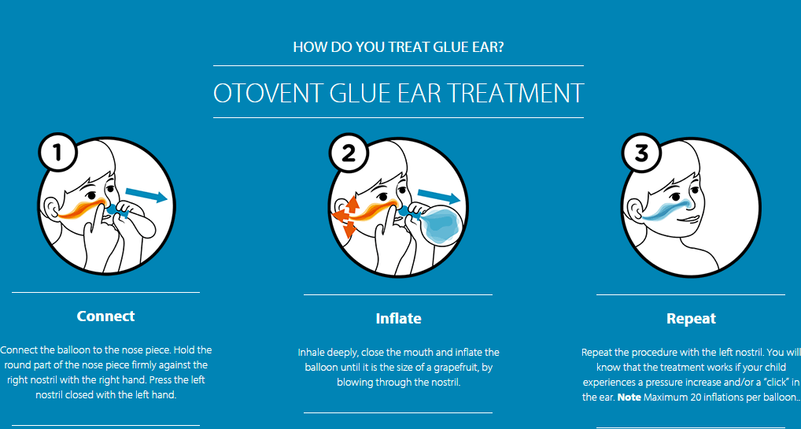
Notes:
These two pictures show some common ways of managing glue ear.Top left picture shows an ear drum with a grommet fitted. The grommet is a tiny tube inserted through the ear drum to allow the sticky fluid to drain. This used to be a really common operation for young children but is used less frequently now due to the need to give the child general anesthetic. They also have varied success often dropping out quite quickly and sometimes on to the classroom carpet! The otivent in the bottom right picture is a simple device the children can get either from their GP or from a local chemist. It involves the children blocking one nostril while blowing up a balloon with the other. You will remember doing something similar to clear your ears on take off. In some Scandinavian countries all young children have a otivent in their school bag and are encouraged to use it regularly throughout the school day

Slide 11
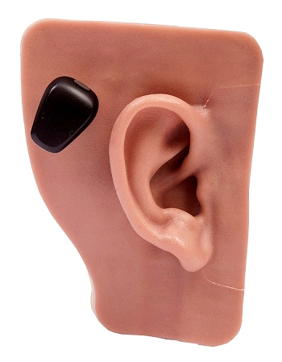
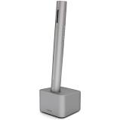
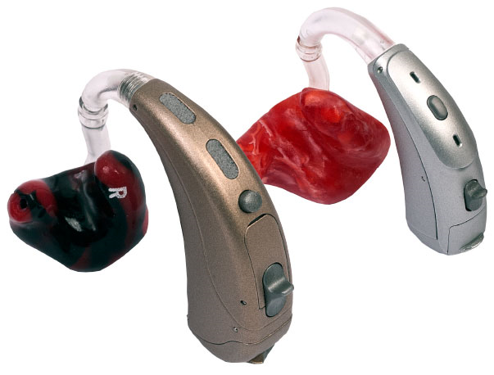
Notes:
these three pictures show some of the technological aids available for children and young people with more serious hearing loss.Top left is a pair of digital hearing aids Which you are probably familiar with. These can be quite difficult for children to get used to and also have the effect of amplifying all sound not just the voice of the teacher so this can be really tiring. when the teacher uses a radio mic this can be attached straight to the hearing aid which helps the child concentrate on the teachers voice. Teachers have to be very careful to remember to turn the radio mic off before attending to have any of their own personal needs! The middle picture shows a cochlear implant this is used We're hearing losses due to damage in the inner ear. Dis involves an operation to permanently fix the fittings for the implant .
The final picture is a Phonak Roger Pen –These are becoming much more common in school for supporting children with hearing loss they are really discreet thanks can be used in a number of different ways

Slide 12
Cochlea Implants
https://www.youtube.com/watch?v=2rhRo73F324
Notes:
watch this video about cochlear implants

Slide 13
Early Years Foundation Stage NDCS note on Department for Education figures on attainment for deaf children in 2017 (England) Updated: 25 January 2018
What the figures show
In 2017, 34% of deaf children were recorded as having achieved a “good level of development” in the early years, compared to 76% of children with no identified SEN. The proportion of deaf children reaching this level has increased from 32% in 2016. It remains of concern that around two thirds of deaf children arrive at primary school having not achieved a good level of development in the early years. Writing, reading and speaking remain the most challenging of the 17 early learning goals for deaf children – with less than half of deaf children reaching the expected standard in each of these goals.
Notes:
That means that 66% of children did not achieve a “good level of development” in their Early years check against 76% of children with no hearing loss.
Have a look at the Early Learning Goals and consider how impaired hearing may be impacting on each goal

Slide 14
Key Stage 1 NDCS note on Department for Education figures on attainment for deaf children in 2017 (England) Updated: 25 January 2018
What the figures show
Deaf children’s attainment at Key Stage 1 has increased across all measures. However, around half of deaf children still failed to achieve the expected standard at Key Stage 1 for reading (49%) and maths (49%)
Notes:
Remember hearing loss DOES NOT indicate any intellectual impairment

Slide 15
Key Stage 2 NDCS note on Department for Education figures on attainment for deaf children in 2017 (England) Updated: 25 January 2018
What the figures show
61% of deaf children are leaving primary school having failed to achieve the expected standard at reading, writing and mathematics compared to 30% of children with no identified SEN. Deaf children fall behind as they progress through primary school, compared to their peers of the same ability – their progress score on reading is minus 1.1 compared to +0.3 for children with no identified SEN.

Slide 16
Mild Hearing Loss Signs to look out for
Delayed speech.
Mishearing and mispronouncing words.
Not hearing what's going on if there's background noise.
Problems with concentrating, tiredness and frustration that affects their behaviour.
Preferring to play alone.
Difficulties with reading and learning.
Wanting the volume of the TV higher than other members of your family.

Slide 17
Impact of hearing loss Expressive Language
A delay in learning to speak
Verb tenses incorrect
Unclear speech
Shouting or talking over loudly
Speaking very softly

Slide 18
Impact of hearing loss Comprehension
Missing or misunderstanding little words in speech (in, on etc)
Difficulty with listening and attention
Say pardon, eh, what.
Not “ear-wigging”!

Slide 19
Impact of hearing loss Behaviour
Not responding when you call or use their name
Not following instructions
Reluctant to join in
Temper tantrums or disruptive behaviour
Becoming withdrawn
Continuing with an activity when others have stopped
Inattentive and “daydreaming”

Slide 20
Impact of hearing loss Self help skills
Constantly asking for repetition, pardon, what,eh.
Watching others before doing it themselves
Watching face or lips intently
Attempting to control conversation by talking
Frequently asking for help from friends

Slide 21
A deaf adult says …
“Many people don’t realise how exhausting listening, concentrating, filling in gaps, guessing the subject, and deciphering body language, lip patterns and facial expressions, is.” – Deaf adult
Notes:
This is something you will have to remember when you are teaching – think about ways that you can reduce the “burden”.
go to the group discussion from this slide and add some ideas you may have to support a child with mild to moderate hearing loss in your classroom. Remember you might not know which children are having difficulties with their hearing at any one time in the classroom. And the child themselves may almost certainly not realise but they are experiencing something different to their peer group

Slide 22
How to support children with hearing loss
Before you speak
Get the child’s attention before speaking
Do not give too many instructions at once
When you are speaking
Talk normally try not to exaggerate lip movements
Use lots of visual clues, demonstrate where possible
Repeat key words
Environment
Sit the child at a suitable distance away from you
Reduce background noise
Make sure the room is well lit and don’t stand with your back to a window
Get down to their level to speak

Slide 23
Hear to Learn
Good communication
Adapting resources

Slide 24
Inclusive Planning
Find a lesson plan (either one of your own or from TES or Twinkle
Where might you need to make adjustments for a child with a hearing loss
What will the teacher have to be aware of while teaching the lesson.

Slide 25
Specialist support Teacher of the Deaf
Teacher of the Deaf
Read about this specialist teacher role and watch the videos of interviews with qualified teachers of the deaf

Slide 26
Communication methods
BSL
Total Communication
Cued Speech
Natural Aural
Auditory Verbal
BSL used exclusively Right to sign
Flexible use of multiple methods –e.g. signing, lip reading, finger spelling, gesture. Used in whatever combination works for the child
Hand gestures draw attention to and support spoken words, each sound is signed near the mouth Cued Articulation
Natural Aural – Listening and talking is emphasised in the natural environment (i.e. not taught). This is the most commonly used approach by Teachers of the Deaf
Auditory Verbal – a specific listening and speaking approach delivered by licenced teachers not common in the UK
Notes:
Deaf community, can never get left out if you live in that community otherwise you depend on others to communicate with you.
Nothing specific, allows access, may tend towards the child’s strengths
“Research shows that, with Cued Speech, 96% of spoken language can be lipread accurately”

Slide 27
More resources to look at
https://www.theguardian.com/science/2014/mar/16/bionic-ears-cochlear-implants-transformed-lives-children
Hear to Help Videos
Join the National Deaf Childrens’ Society – its free. Download – Communicating with Your Deaf Child.

Slide 28
The Silent Child
The Silent Child
This film won Oscars a couple of years ago and was highly acclaimed by the deaf community
Unfortunately it costs a small amount to download but please try to watch it if you can. It last 20 minutes
Notes:
Film 20 mins on Google Play (45)

Slide 29
Visual impairment
A visual impairment is vision which can not be fully corrected by the wearing of glasses.

Slide 30
Identifying children with sight loss
Red or watery eyes
Eyes in constant motion
Finding tasks unusually tiring
Poor hand eye co-ordination
Unusual head posture
Sensitivity to light
Bending closely over work
Lots of blinking, squinting, rubbing eyes

Slide 31
Types of sight loss
Low acuity – sharpness of image, can be near or distance or both
Central vision loss – can move around relatively easily but close tasks such as reading can be difficult
Peripheral vision loss – good central vision meaning close work can be possible but moving around is difficult
Patchy vision – means scanning to build up the whole picture, complicated visual tasks can be hard
Low contrast sensitivity – hard to pick out things that are close in shade or colour. Can be hard in some environments
Eye movement difficulty – for example Nystagmus, where the eye is constantly moving, makes tracking difficult
Colour Blindness – not considered a sight loss but can accompany other conditions

Slide 32
What do you need to know about a child’s sightloss courtesy of the RNIB - Access to Education
Is their sight stable or is it variable? If so, under what conditions?
What is the extent of their effective distance vision, for example, for reading from the whiteboard?
What size and style of print can they read comfortably?
Is their field of vision normal or restricted? For example, is peripheral vision reduced or are areas within the visual field missing? How does this affect their ability to work with diagrams, maps, etc?
Is there a limited time over which the learner is able to use their sight efficiently before their eyes become tired?
How competent are they in moving around the classroom independently and safely?
Do they have particular preferences regarding the classroom environment, such as the nature of the lighting, seating position, or the use of the whiteboard?

Slide 33
What do you need to know about a child who is blind?
How much sight, if any, do they have? How useful is it and for what activities?
What level of skill do they possess in braille and other tactile skills? In particular, what is their speed of reading?
What experience of the visual world, if any, do they have? Have they ever seen and therefore possess any visual memory?
Do they tire easily? Is there a limited period of time over which they can work efficiently?
How competent are they in moving around the classroom independently and safely?

Slide 34
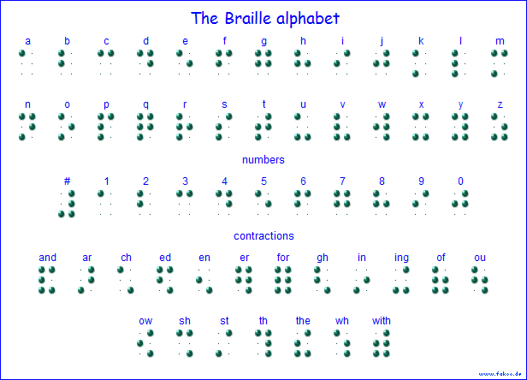
Notes:
Teaching and leaning braille is a skilled job and will be done by a specialist teacher
Can you write your name in Braille?
Come and Braille it

Slide 35
What can you do to support?
Sit child near to and facing the front
Ensure good levels of lighting whilst avoiding glare.
Use the child’s name
Use pens which provide a good contrast when writing for the child
Allow longer for examining resources or demonstrations
Don’t ask the child “can you see that?” No one knows what they cannot see.

Slide 36
Inclusive environments Courtesy of the RNIB
Signage – clear, well positioned and easily visible, perhaps using braille or symbol.
Steps, edges, pillars and other transition points highlighted with yellow paint.
Handrails to help with mobility.
‘Tactile trails’ – dado rails or other textured materials at hand height, that learners can follow to find the route to a particular location in school − eg toilets, dining hall.
Different floor coverings for different areas of the school to indicate a change of environment.
Clear panels on doors so people can be seen approaching from the other side.
A distinction between quiet and active areas in the playground, and shaded areas for learners with light sensitivity.
Sensory gardens.
Well-maintained grounds, free of obstructions.
Corridors, cloakrooms and classrooms kept free of obstructions.

Slide 37
Teaching Position
Avoid standing in front of windows - this can reduce you to a silhouette and make it difficult for all learners to see you properly.
Learners who have VI need to sit in the best position to see the whiteboard, etc, but not separately from the other learners.
Do learners with vision impairment need to sit close to a power source if they are using ICT devices?

Slide 38
Garry’s Visualiser
Notes:
Can you see any issues with having this equipment in your classroom? In terms of inclusion? Practically?

Slide 39
Garry’s Visualiser with book

Slide 40
Garry’s visualiser with book … and Garry!

Slide 41
ipads
Explore the accessibility features available on the ipads

Slide 42
Social Inclusion
They may have difficulty in observing and imitating their peers which can impact on the development of age appropriate behaviours. A child may miss out on some of the visual clues and body language that people use to establish friendships.
They may be more dependent on their parents in many areas, which may adversely affect the development of a sense of independence, one of the most important factors in relation to their self esteem and adjustment.
They may experience greater feelings of failure, particularly in relation to sport and exercise.
They may be less accepted by their peer group and have fewer friends which is likely to impact on their self esteem.

Slide 43
Teaching and learning resources
Are the print resources you use in an appropriate format for learners? (Consider print size, font and contrast. When working with vision impaired learners you should take advice from the learner, their parents/carers, the Special Educational Needs Coordinator (SENCO) or the QTVI, as appropriate.
Do learners have a good reading position? (Reading stands or raised boards are useful to help some learners get the best reading position.)
Do you use real objects and artefacts to support your teaching?
Do learners who use special equipment or large print resources have adequate space to work?

Slide 44
Wikkistix Challenge
Can we make a tactile world map with wikkistix?

Slide 45
Blind School
https://www.bbc.co.uk/sounds/play/p06zy5h1
Radio 4 Drama

